Slide 1

Modernising INSPIRE: reusable tools & governance of artefacts
Marco Minghini & Alexander Kotsev
GO-PEG Workshop #3 – June 29, 2021

Slide 2

Sustainability of INSPIRE components
  INSPIRE components in the past:
    created in different periods with different technologies
    rooted into the infrastructure of the JRC
    expensive and difficult to maintain
  INSPIRE components in the future:
    rely on mature, open source and out-of-the-box technology
    focus on the INSPIRE-specificity and not on mainstream tool development
    build strategic partnerships with communities
    harmonise the approaches for helpdesk
    decouple tools from infrastructure
    extensive use of the cloud for sustaining the tools

Slide 3
INSPIRE Geoportal – New backend
  Release of a prototype of the Geoportal backend based on GeoNetwork:
    reference catalogue application, open source, official OSGeo project
  Main features:
    micro-service approach for harvesting
    harvesting dashboard (aka harvest console) protected through EU Login
    harvester core, with custom configurable options and capabilities:
      complete coverage over the harvest of 35 endpoints currently available in the INSPIRE Geoportal, comprising the incremental harvesting feature
      data-service linkage assessment, covering the current approach as well as the new simplified approach (WIP)
      automated translation of metadata fields through EC DGTranslation services
      full support for OGC Filter

Slide 4
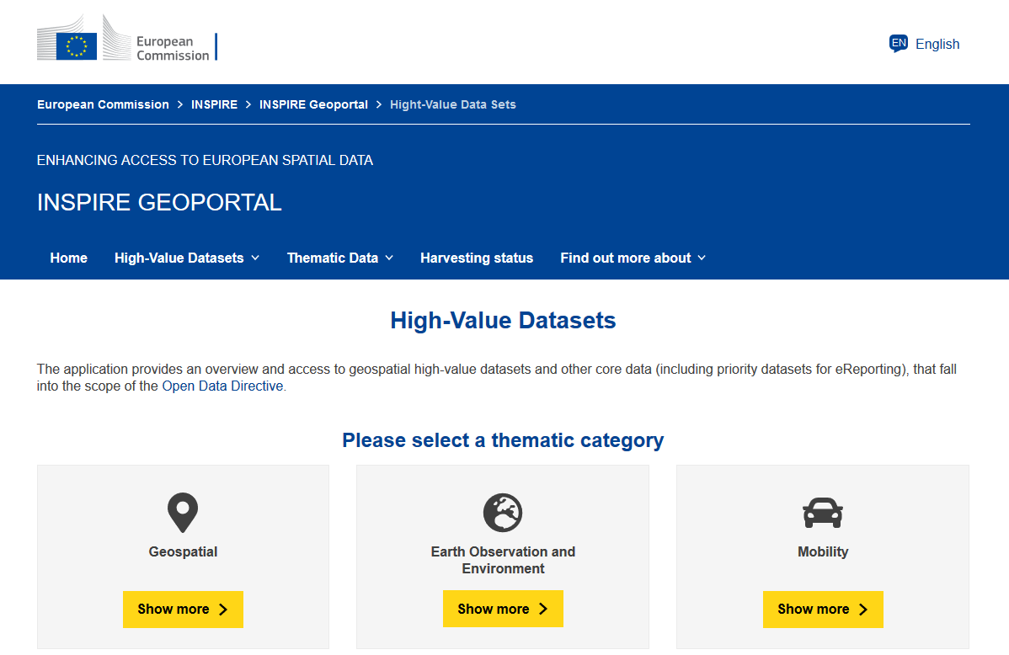
INSPIRE Geoportal – New frontend
Will introduce 2 new features:
  new UI aligned with the visual identity of the European Commission
  new filters based on the (provisional) list of high-value datasets
Release expected to take place after the publication of the Implementing Act on high-value datasets (autumn 2021)

Slide 5
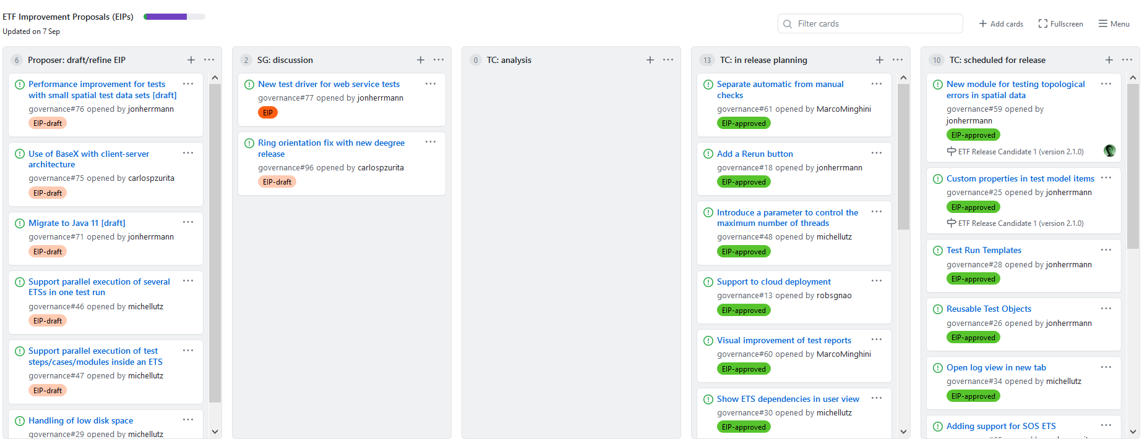
Upcoming release of the ETF framework
v.2.1 to be released soon, will fix some INSPIRE-specific issues:
  GML polygon orientation (caused by a deegree issue) [#60, #137, #147, #886]
  invalid geometries (CRS issues) [#203, #214, #267, #301]
https://github.com/orgs/etf-validator/projects/2

Slide 6
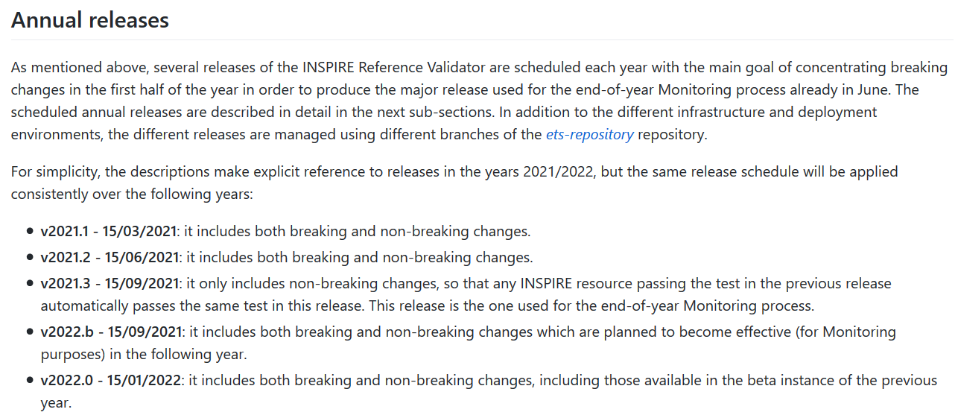
INSPIRE Reference Validator – Releases
latest release
used for Monitoring and Reporting 2021
https://github.com/INSPIRE-MIF/helpdesk-validator/tree/master/release%20strategy

Slide 7
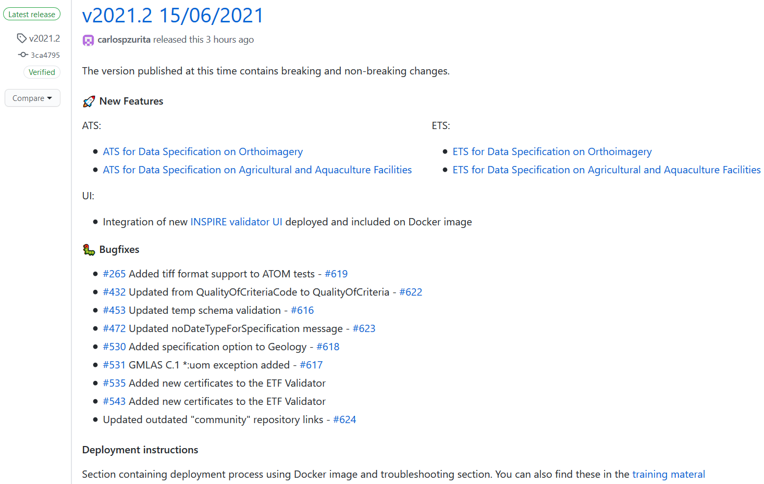
INSPIRE Reference Validator – Latest release
https://github.com/INSPIRE-MIF/helpdesk-validator/releases/tag/v2021.2

Slide 8
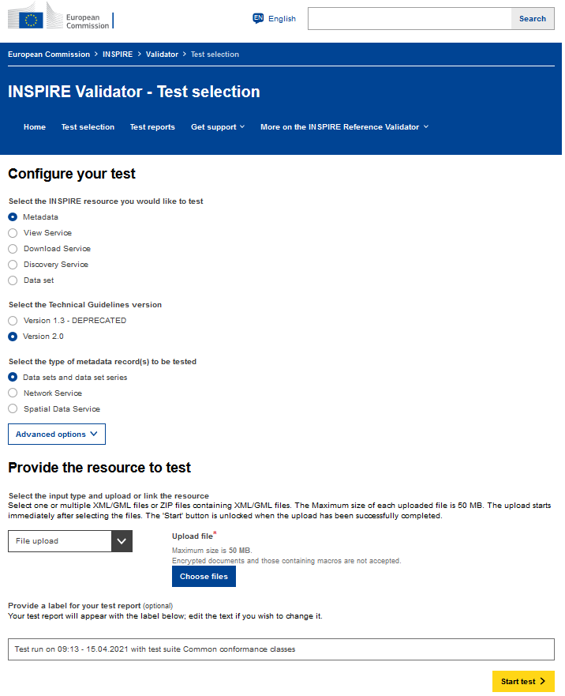
INSPIRE Reference Validator – New UI
Available for the first time in the production instance with release v.2021.2:
  aligned with the visual identity of the European Commission
  simplified workflow for starting tests
  captcha to prevent machine interaction
https://inspire.ec.europa.eu/validator

Slide 9
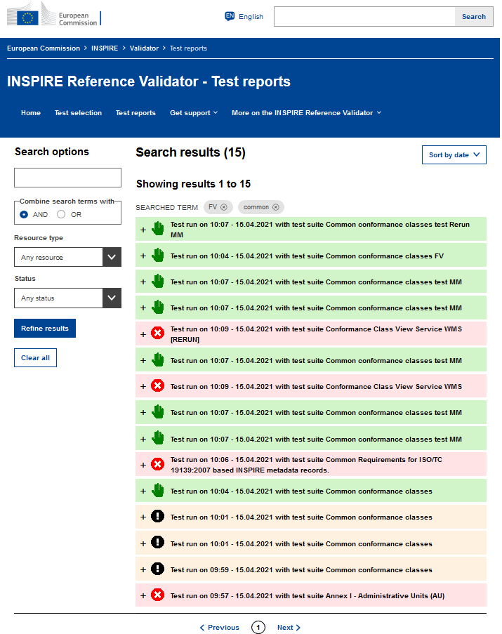
INSPIRE Reference Validator – New UI
Available for the first time in the production instance with release v.2021.2:
  aligned with the visual identity of the European Commission
  simplified workflow for starting tests
  captcha to prevent machine interaction
  new visualization of test reports with improved options for filtering
https://inspire.ec.europa.eu/validator/test-reports

Slide 10
INSPIRE Reference Validator – Coming soon
Annex II/III theme-specific requirements | https://github.com/INSPIRE-MIF/helpdesk-validator/issues/336
  ATS: all completed
  ETS: only missing MR, ER, OF, AC-MF
OGC API - Features | https://github.com/INSPIRE-MIF/gp-ogc-api-features/
  transposition of the tests currently available in the OGC TEAM Engine: available soon
  development of the INSPIRE-specific tests: planned
OGC SensorThings API | https://github.com/INSPIRE-MIF/gp-ogc-sensorthings-api
  planned after summer
Requirements for discoverability of IACS datasets:
  planned after summer

Slide 11
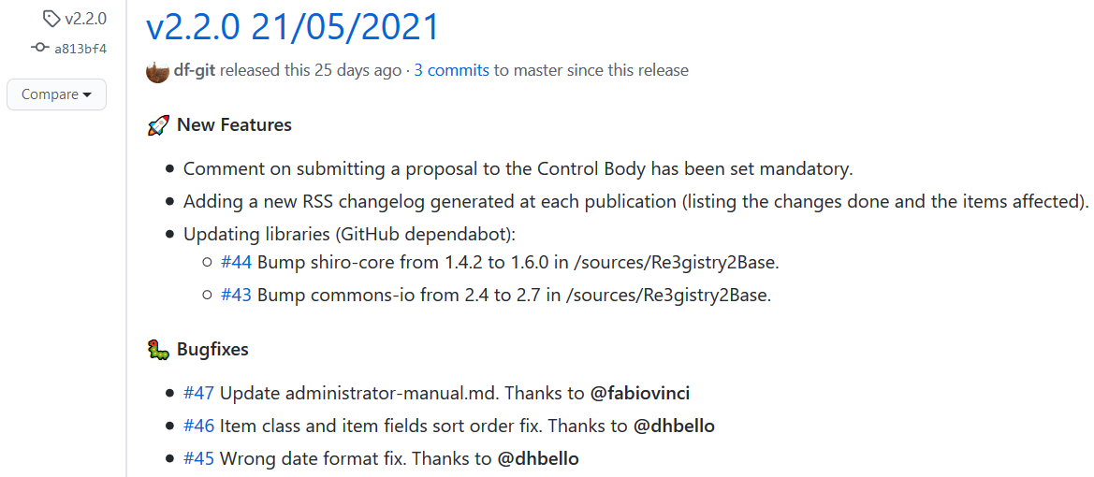
Re3gistry open source software
New bugfix release (v.2.2.0) released in May (EUPL license v1.2)
https://github.com/ec-jrc/re3gistry/releases/tag/v2.2.0

Slide 12
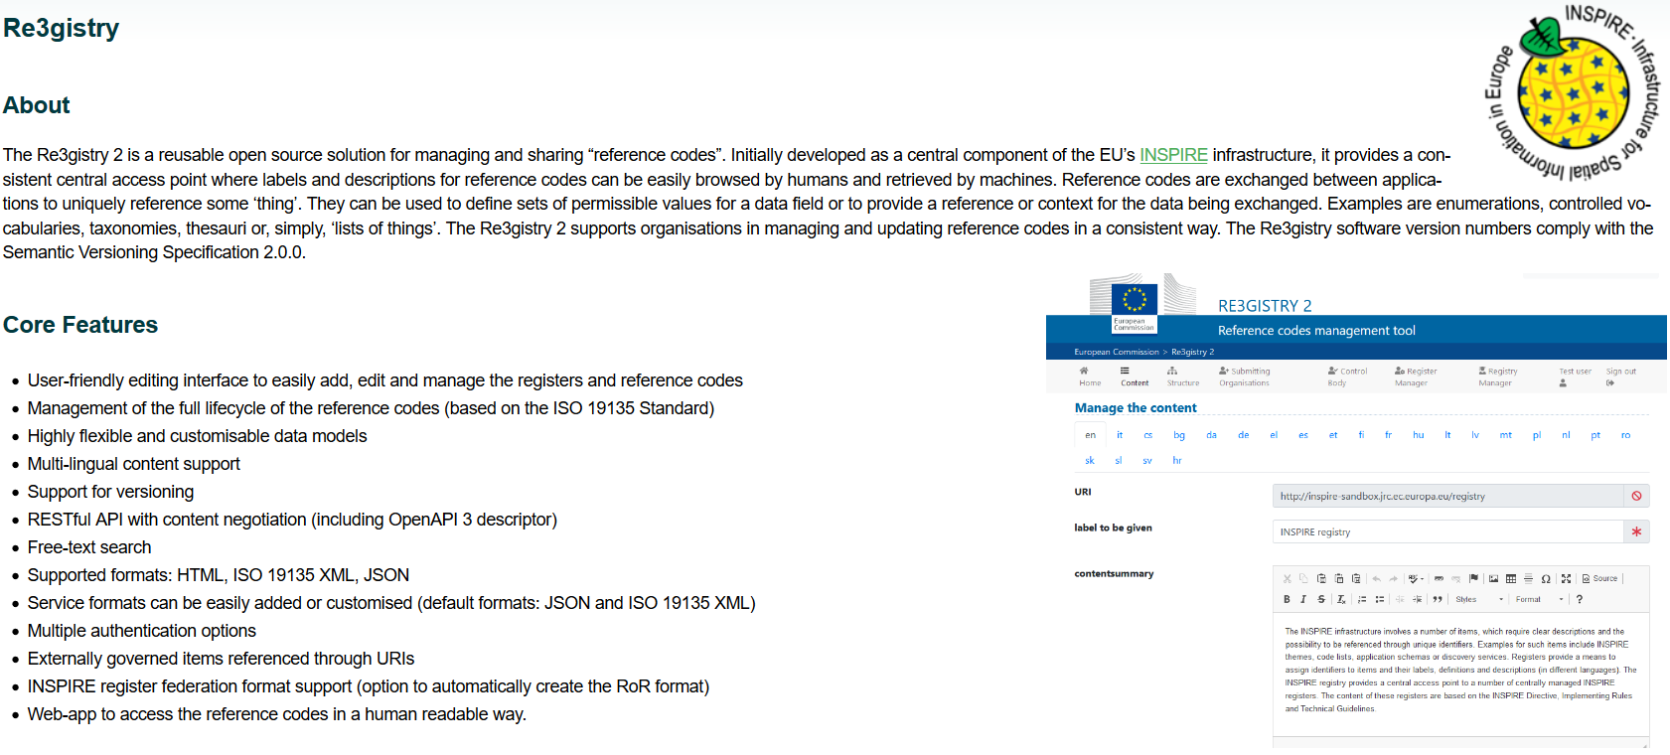
Re3gistry open source software
New bugfix release (v.2.2.0) released in May (EUPL license v1.2)
Included for the first time in the OSGeoLive distribution
https://live.osgeo.org

Slide 13
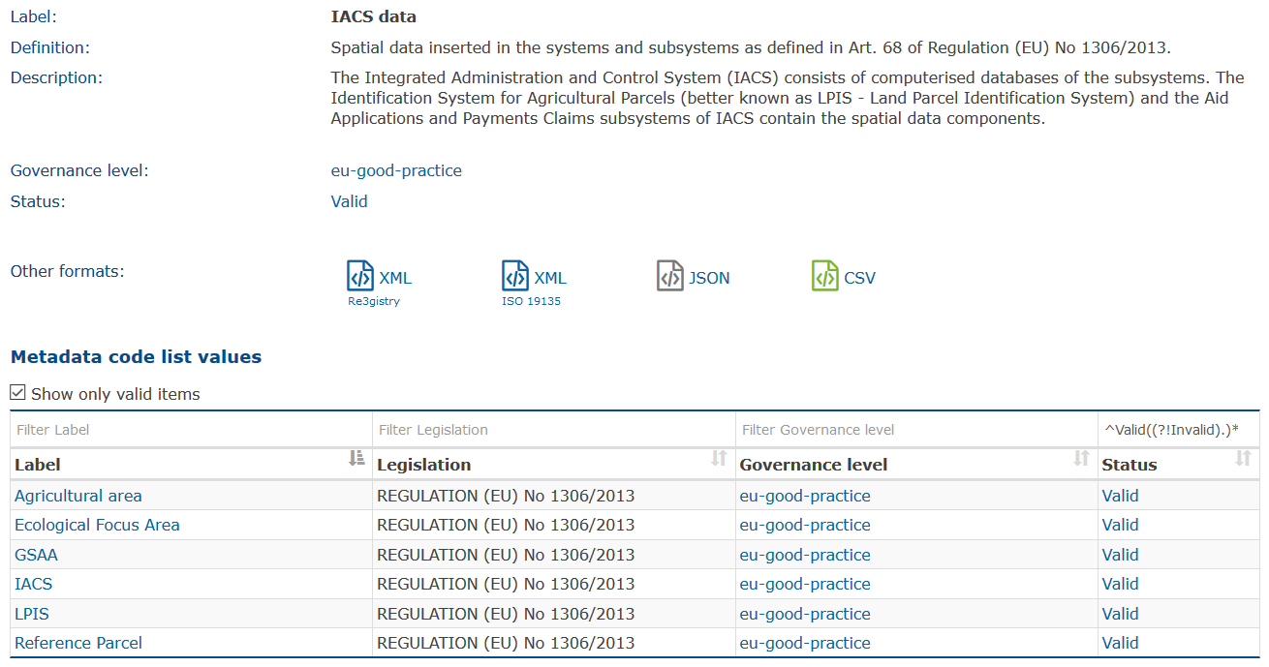
INSPIRE Registry
New codelist for IACS datasets:
https://inspire.ec.europa.eu/metadata-codelist/IACSData

Slide 14
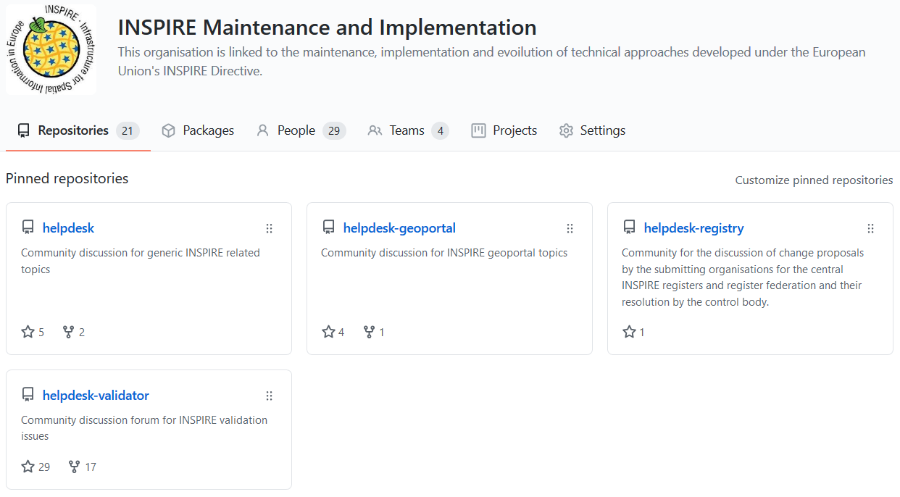
Helpdesks of all central components
All centralised and moved to GitHub:
INSPIRE Geoportal helpdesk
General INSPIRE helpdesk
INSPIRE Registry helpdesk
INSPIRE Reference Validator helpdesk
https://github.com/INSPIRE-MIF

Slide 15
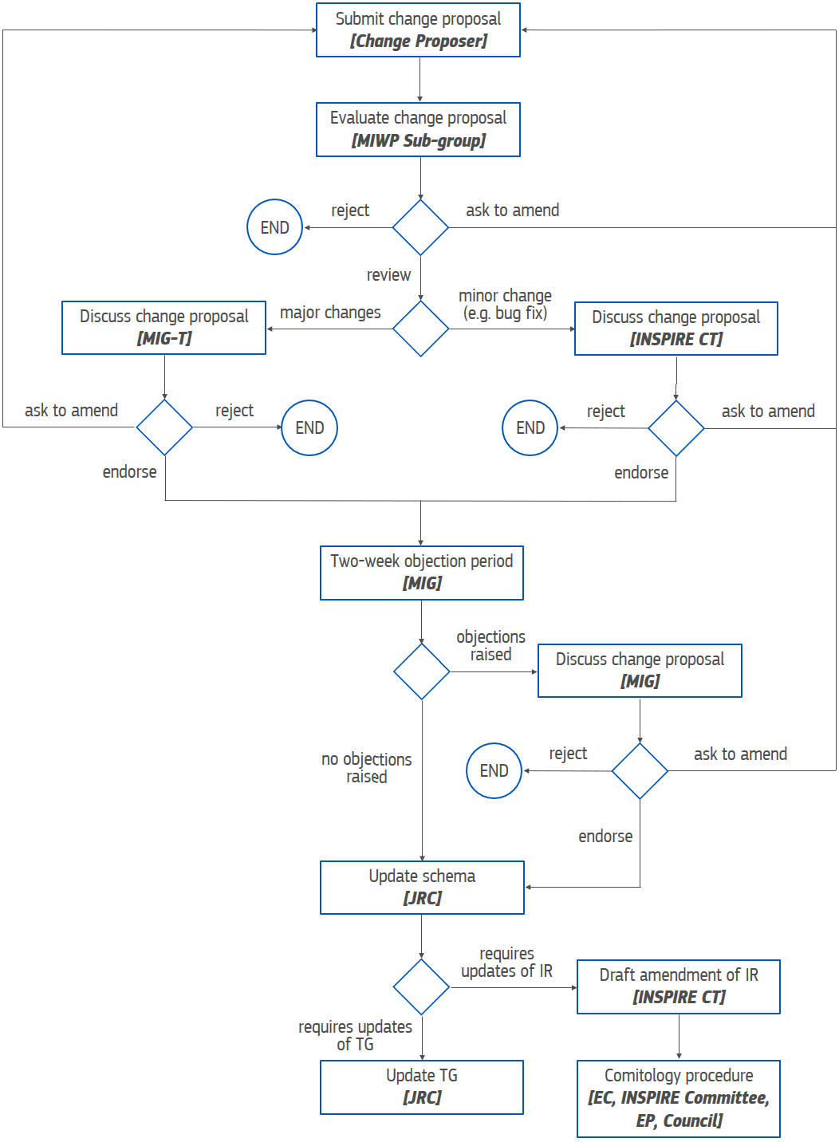
Governance of INSPIRE artefacts (schemas/TGs)
New governance approach for XML schemas and TGs, defining:
  the stages of the process, actors, rules, roles, responsibilities and timelines
  the release plan
  the practical tools to be used in the process
https://github.com/INSPIRE-MIF/application-schemas/blob/main/governance-release-process/process.md
https://github.com/INSPIRE-MIF/technical-guidelines/blob/main/governance-release-process/process.md

Slide 16


Operationalisation of the approach – GitHub
New repositories for INSPIRE schemas and TGs
  https://github.com/INSPIRE-MIF/application-schemas
  https://github.com/INSPIRE-MIF/technical-guidelines
including:
  concrete artefacts (to allow pull requests)
    schemas already uploaded, TGs being converted to AsciiDoc
  description of the governance process
  release plan
  template for change proposals
  issue labels
The new approach is already usable!

Slide 17

Thank you!
marco.minghini@ec.europa.eu
© European Union 2020
Unless otherwise noted the reuse of this presentation is authorised under the CC BY 4.0 license. For any use or reproduction of elements that are not owned by the EU, permission may need to be sought directly from the respective right holders.

Slide 18





Keep in touch
EU Science Hub: ec.europa.eu/jrc
@EU_ScienceHub
EU Science Hub – Joint Research Centre
EU Science, Research and Innovation
Eu Science Hub
Notes:
Delete/update as appropriate

