Slide 1
GO-PEG
Schema creation and transformation processes
"A step towards High Value Datasets"

Slide 2
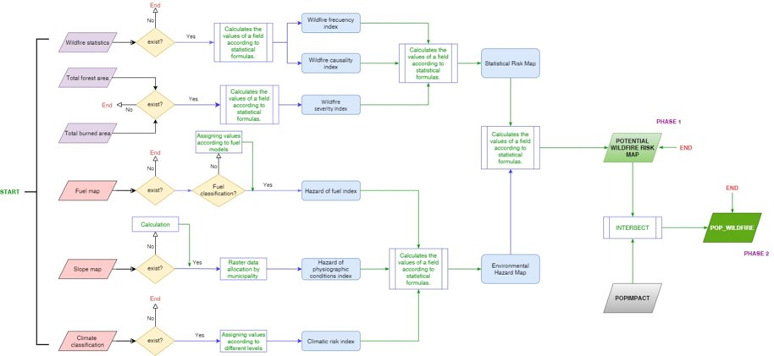
POP-WILDFIRE Use Case description
Wild fires cause incalculable environmental and economic losses every year, and threatens several populated areas.
The aim of POP_Wildfire is to obtain the POTENTIAL WILDFIRE RISK, and in a second phase to assess the vulnerability for the population directly affected by this threaten.
Data flow image used to define the model

Slide 3
POP-WILDFIRE challenges: Schema harmonisation
  Understanding how the different data sources can be included into the model.
  First challenge has been the identification of pan-European datasets with valid data to be included in a model that was originally design using datasets available only for Spain.
  Need for data pre-processing to adapt the existing pan-European datasets into the suitable schema to feed the process.
      The use of national/regional level datasets in the original study and the difficulty to find valid pan-European datasets to be used, clearly exemplify why we need INSPIRE, the European directive for spatial data interoperability.
  Lack of metadata in datasets identified as source of relevant information (not aligned with INSPIRE), making impossible their use.

Slide 4
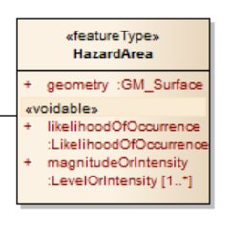
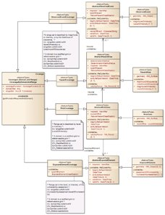
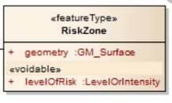
POP-WILDFIRE challenges: Schema creation
  The final output will be enclosed within the Annex 3 > Natural Risk Zones
  Adapting the outputs of the existing methodology to match the different feature Types within the INSPIRE directive has been identified as a potential loss of relevant information.
  Use of the existing INSPIRE UML model as a frame reference to define the new output model, capturing the relevant information associated to the different features.
    PHASE 1 output (Potential Wildfire Risk Map) and intermediate outputs more aligned with RiskZone feature Type
    PHASE 2 output (POP_Wildfire) more aligned with HazardArea feature Type

Slide 5
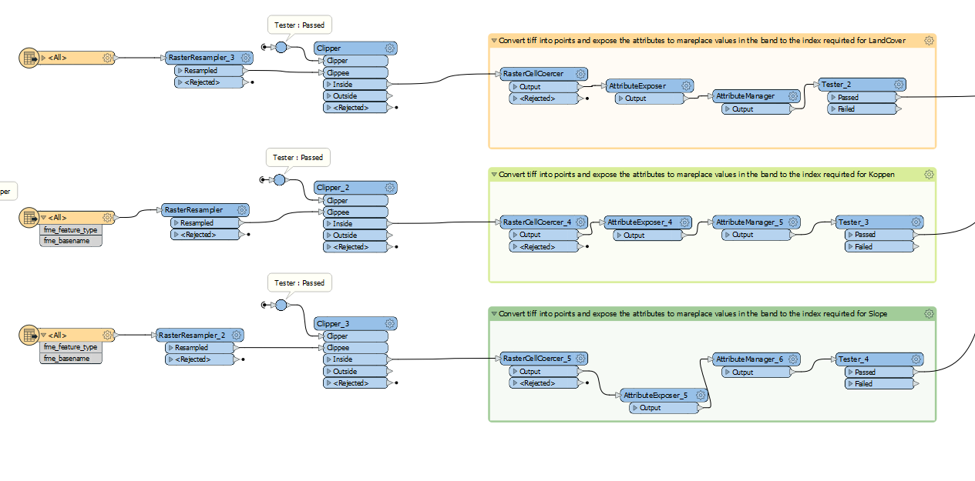

POP-WILDFIRE challenges: Data transformation
Need for data pre-processing to adapt the existing pan-European datasets into the valid schema to feed the process.
Existence of different vegetation & bioclimatic models that need to be comparable
Differences in spatial resolution on the input datasets that need to be corrected

Slide 6
THANK YOU

