Slide 1
GO-PEG Workshop 3 – 29th June 2021
Schema creation and transformation processes
The fAIRPORT use-case
Secure and fair integration of UAS in air space
Claudia Schulte, wetransform GmbH
Notes:
Unmanned aerial vehicle

Slide 2
fAIRPORT – Flight Area Artificial Intelligence Retrieval Portal
Secure and fair integration of UAS in air space
Unmanned aircraft system / Unmanned aerial system / Unmanned Aerial Vehicle…not harmonized…
Final Goal
  Geospatial data model and dataset for UAS regulation zones
  GIS Platform providing information on flight regulation zones for UAS
Short Overview over the iterative processing steps
  Requirements identification, Agreement upon data model concept → Conceptual schema design
  Encoding Selection (GeoJSON) → Operational/Logical schema design
  Map available source schemas into the operational target schema → Schema Mapping
  Transform and validate source data into the target model → Data Transformation
Further information on UAS regulations
  European Union Aviation Safety Agency

Slide 3
fAIRPORT – Conceptual Model (Main Types)
UASZone (abstract)
Authority
A relevant authority that is in charge for authorising, being notified or providing information for UAS operations in the UAS Zone
UASRegulationZone
An airspace of definied dimensions, above the land area or territorial waters of a state, within which a particular restriction or condition for UAS flight applies
Metadata
Condition
An indication of the conditions under which the zone can be used
ObjectDefinition
Real world object that causes the UASZone
TemporalDefinition
Defines the applicability dates and times of the zone

Slide 4
fAIRPORT
Source data and target data set
Resulting Target dataset
  UASRegulationZones (minimum 2,5 D) including risk classes as defined in the regulations
    Geoobjects that initiate UASRegulationZones including object width and object height
  Required Source data
  Orthophotos
  Digital Elevation Model (DEM) and/or Digital Terrain Model (DTM)
  Building Footprints 2,5 D + Usage Classification
  Transport Network (Rail, Road, Air, Water)
  Protected Areas
  Up-to-date hazard information
  Up-to-date data on events with human crowds

Slide 5
fAIRPORT
INSPIRE data of interest and possible INSPIRE target scheme
Target INSPIRE Theme could be:
  INSPIRE Area Management – ManagementRestrictionOrRegulationZone
    Definition: Area managed, restricted or regulated in accordance with a legal requirement related to an environmental policy or a policy or activity that may have an impact on the environment at any level of administration (international, European, national, regional and local).
INSPIRE Themes of interest as source data:
  Land Use → Classify GeoZones
  Cadastral Parcels → Exact definition of GeoZone based on Parcels and Landuse
  Buildings → Exact definition of GeoZone based on Buildings (2,5 D)
  Protected Sites → Flight ban in specific protected areas
  Energy Resources → Flight ban over specific energy resources (biogas, power plants..)
  Transport Networks → Flight regulation over transport network
  Elevation → Calculation of height of GeoZone
  Utility and governmental services →Flight regulations exist for certain governmental services

Slide 6
fAIRPORT – Tasks and Challenges
  There are several existing data models (DFS GEODM, ED-269, ALKIS, etc) that had to be harmonized
  The resulting target schema needs to fulfil the requirements defined by the stakeholders (Agreement)
  The conceptual model is designed & aligned to the existing models in more than 3 iterations within the conceptual phase
  The decision on the encoding was easy as the, standard ED-269 mandatory requires GeoJSON encoding
  Challenges
    Some use-case Scenarios are underdefined because the related legal processes are not yet clear
    As a result, it is unclear whether parts of the data model are expressive enough
    The agreement on the exact meaning of classes and codelists was challenging as two quite mature standards where involved, that partly differ
    When is the semantic model „good enough“ to be released and proceed with logical model (Iterations!)?

Slide 7
fAIRPORT
Status
Stakeholder exchange established
Conceptual Model (first version) exists
Testdatasets available
Possible INSPIRE data sources identified
Operational Model (First version, GeoJSON) exists
Mapping tests from source to conceptual model in progress
During mapping tests, we realized lacks in conceptual schema (semantic issues) as well as issues related to the schema language.

Slide 8
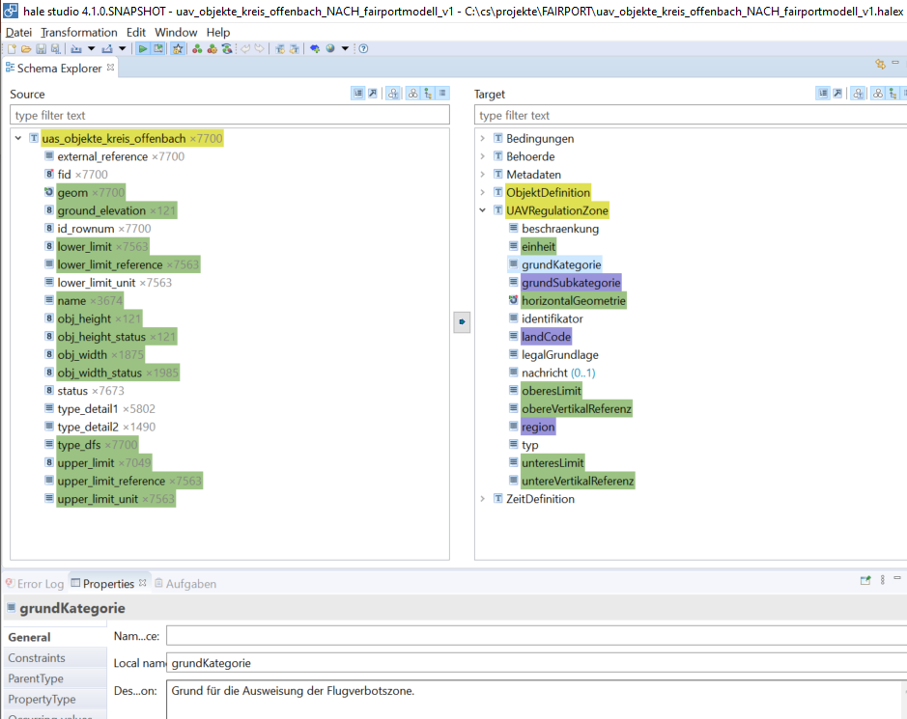
hale»studio, source and target schema
Source
Target
overview and
access to
source schema and
source data entities
overview and
access to
target schema entities and
transformed data
Details on
selected properties

Slide 9
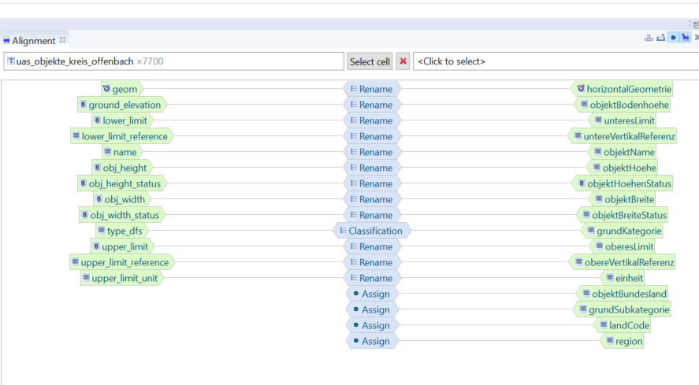
hale»studio
Alignment/Schema Mapping Window

Slide 10
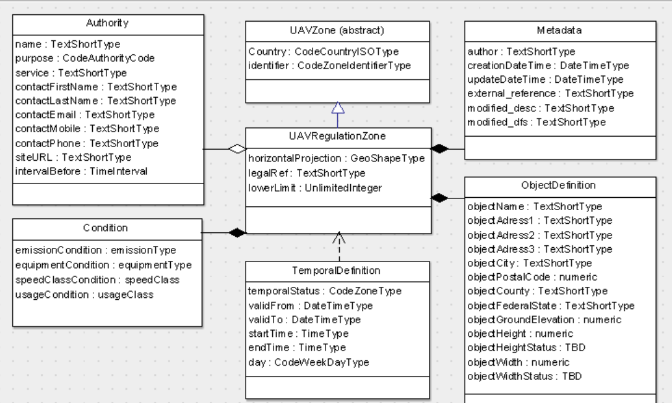
fAIRPORT – Target Data Model

Slide 11
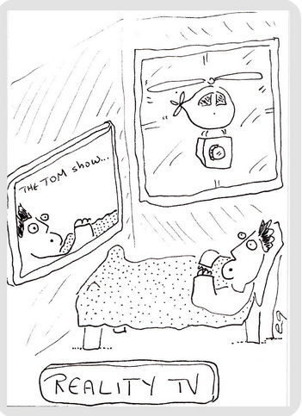
THANK YOU

