Slide 1
GO-PEG schema creation and transformation processes
geoCOVID Watch and GO-DEPTH use cases
"A step towards High Value Datasets“

Slide 2


geoCOVID Watch use case: overview
Why this use case: several organizations around the world offer access to COVID-19 related data. However, data is difficult to integrate and compare across countries as data sources are heterogeneous in terms of data formats and protocols.
- statistical metrics
  indicators and their definitions
- data aggregation process
  little provenance data + no clear methodology
- country response measures
  comparability of national testing strategies
- data sharing
  excel /csv most used for COVID-19 data collection → duplicates /data losses /late updates
geoCOVID Watch stakeholder:
Austrian IT company supporting the public and private sectors in managing the more dynamic aspects of their spatial data

Slide 3
geoCOVID Watch challenges
Challenge: lack of data interoperability →data is difficult to integrate and compare across countries.
Solution: investigate benefits geospatial data coupled to state-of-the-art technologies can bring to common understanding of the Covid-19 pandemic and its impacts.
How we are implementing this solution:
  using standards
      RESTful APIs → browser-based access to data + simple application development
  reusing good work ongoing/already available + cooperating with community

Slide 4
geoCOVID Watch challenges
Use case outputs:
- Dataset of known initiatives providing data relevant to COVID-19
  Data model: (PostGIS) database model
  Data sharing: OGC API - Features (OGC standard to create, modify and query features on the Web)
  Software solution: GeoServer (kind support by GeoSolution → geoCovid Watch initiatives as test case for GeoServer Smart Data Loader)
- Aggregator collecting COVID-19 related data across Europe
    Data model: STA data model (core data model, based on the ISO/OGC Observation and Measurement (O&M) model
    Data sharing: SensorThings API (OGC standard to interconnect IoT (Internet of Things) sensing devices, data, and applications over the Web)
    Software solution: FROST (collaboration with the API4INSPIRE project)
    Input Data: case data from JRC COVID-19 GitHub + National containment measures data from ECDC website

Slide 5
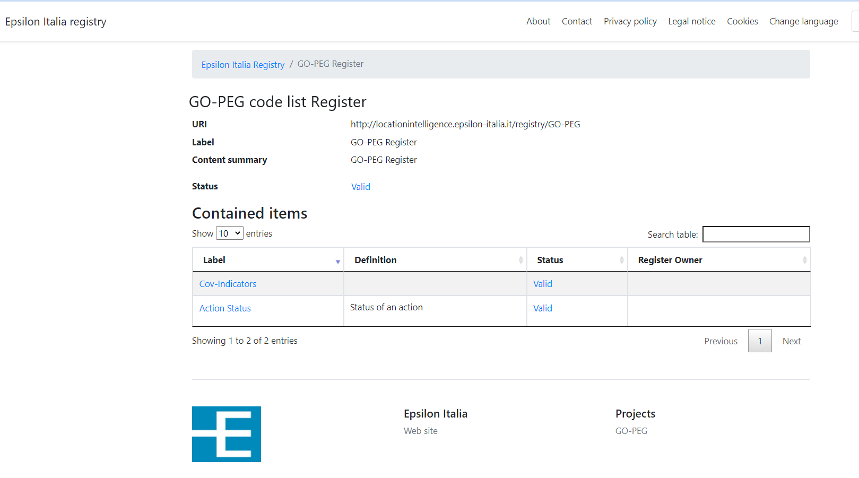
geoCOVID Watch challenges
Challenge: semantic interoperability
Definitions of indicators, methodologies and restriction measures is often not available online, mostly to be found in pdf files and in different websites.
Solution: increase coherence, transparency and interoperability of the data using a registry service
  definitions can be assigned persistent and unique URLs
  existing resources, e.g. available pdf documents, can be linked.
using Re3gistry software, an open-source tool for managing and sharing reference codes through persistent URIs.
The Re3gistry development started under the Are3na action are continued under the ELISE action.

Slide 6

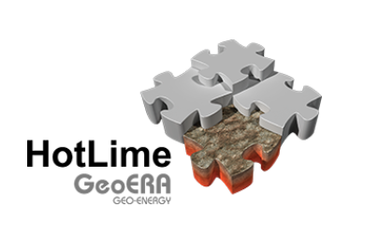

GO-DEPTH use case: overview
Why this use case: provide a methodology to conceptualize, organize and make available easy-to-use, high-quality, interoperable subsurface information for an integrated planning and a sustainable management of resources
GO-DEPTH Stakeholder: Italian Institute for Environmental Protection and Research, ISPRA
Input data:
3D spatial extent of geological units and faults from GeoMol and HotLime EU projects, EPOS boreholes.
Addressed countries:
Italy, France, Switzerland, Germany, Austria, Slovenia (GeoMol project)
Italy, Germany, Austria, Slovenia, Croatia; Spain, Malta, Netherlands (HotLime project)

Slide 7
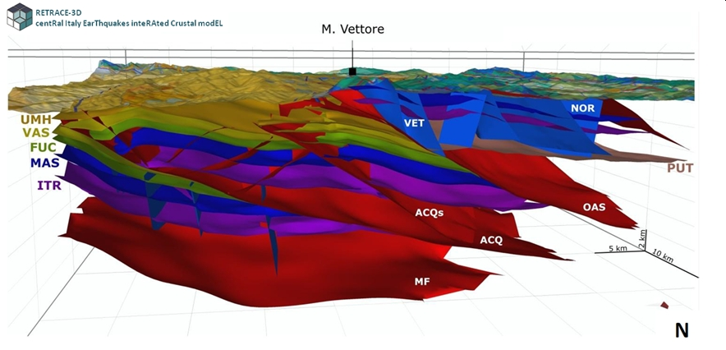
GO-DEPTH challenges
Challenges:
how to handle complexity of 3D subsurface models and relevant 3D geometries
link thematic information to spatial data
Output deliveries:
Layers of harmonised subsurface 3D data for:
geologic units and relevant contact surfaces
faults
boreholes

Slide 8
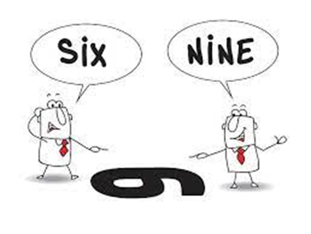
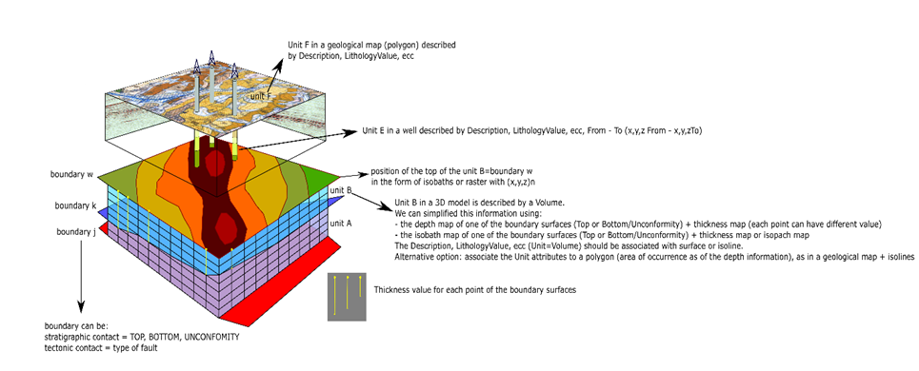
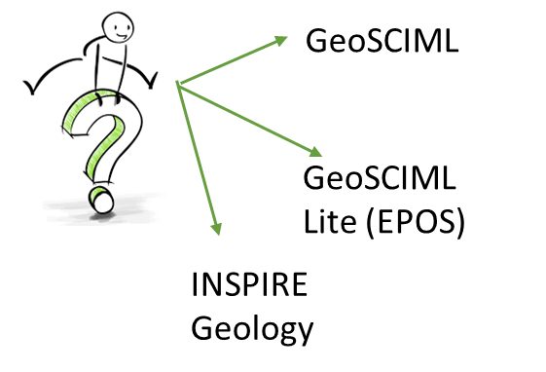
GO-DEPTH challenges
Challenge: data model definition for the Geologic Units and Faults
Build a common understanding: domain vs technical expertise
Choose the output reference model(s) to build upon

Slide 9
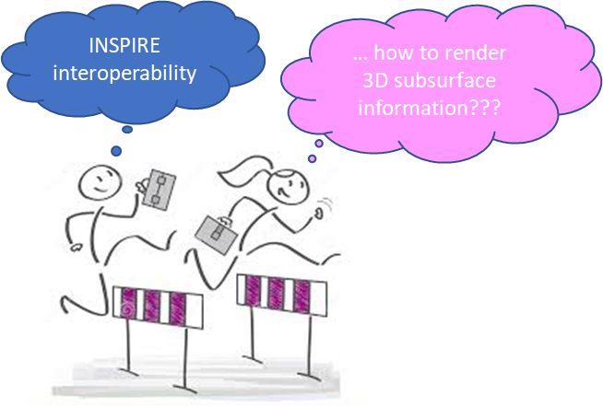
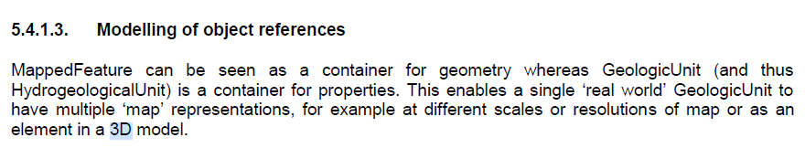
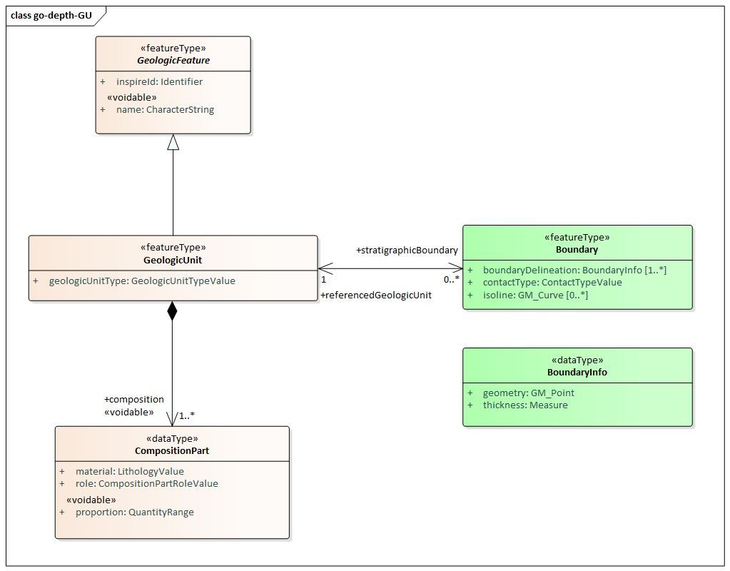
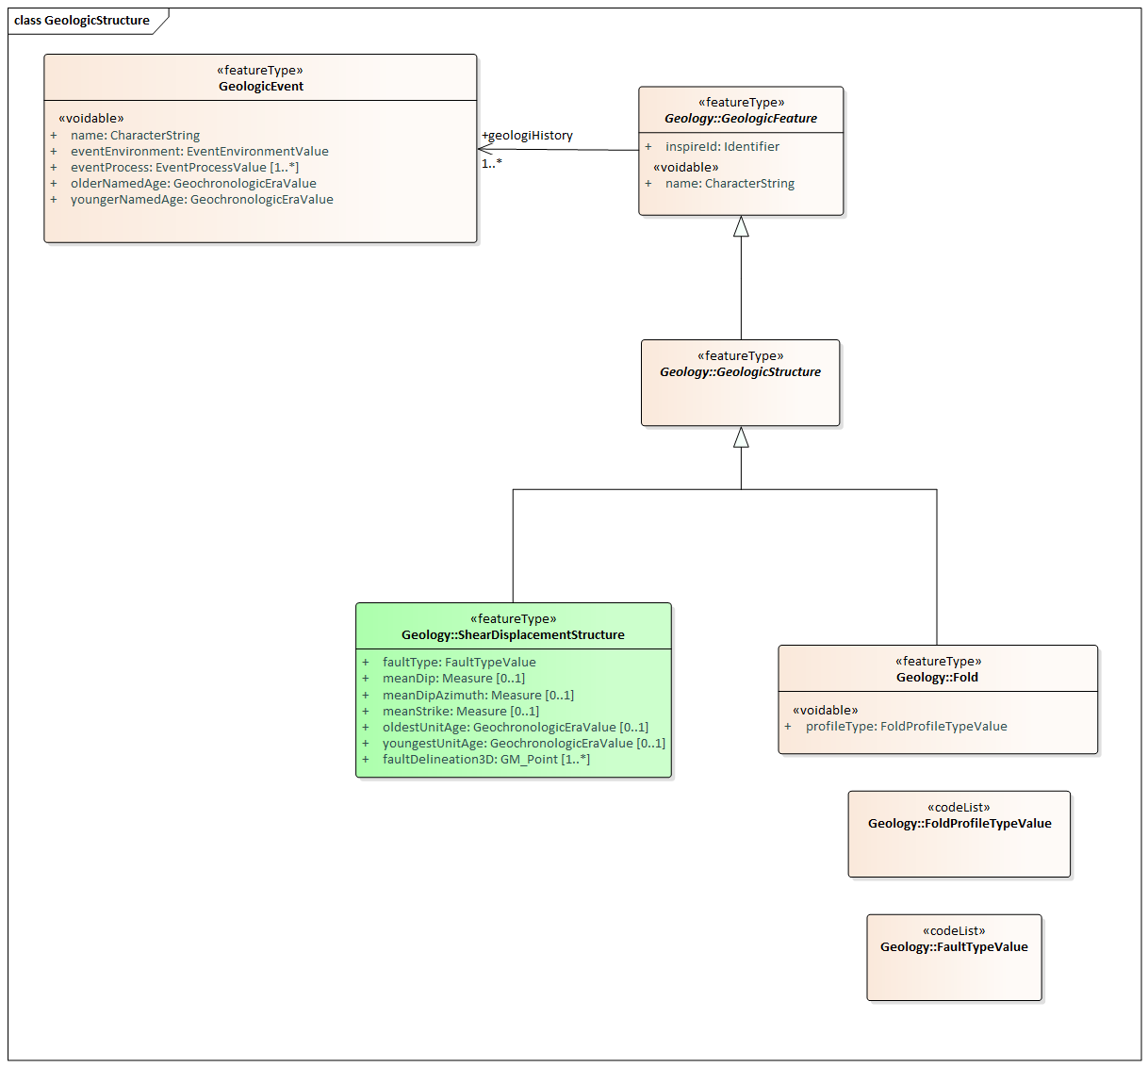
GO-DEPTH challenges
Solution: INSPIRE- extended models for Geologic Units and Faults
INSPIRE GE Data Specification

Slide 10
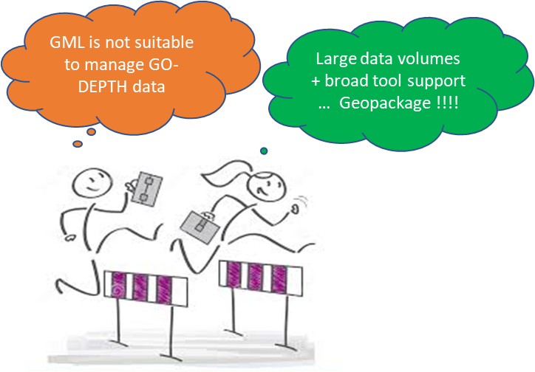

GO-DEPTH challenges
Challenge: creation of the encoding-specific model
INSPIRE- extended data model (UML) → geopackage structures (tables and relationships) without losing interoperability
Solution: INSPIRE Alternative encoding work
GO-DEPTH output will be in line with ongoing work on GeoPackage as INSPIRE Alternative encoding
https://github.com/INSPIRE-MIF/gp-geopackage-encodings - https://github.com/wetransform-os/geopackage-end
https://github.com/IAAA-Lab/U2G/blob/master/GeoPackage/geopackage-encoding-rule.md
Currently only common encoding rules available. Since the INSPIRE GP are community driven → possible theme-specific proposals need to be developed by the thematic communities!

Slide 11
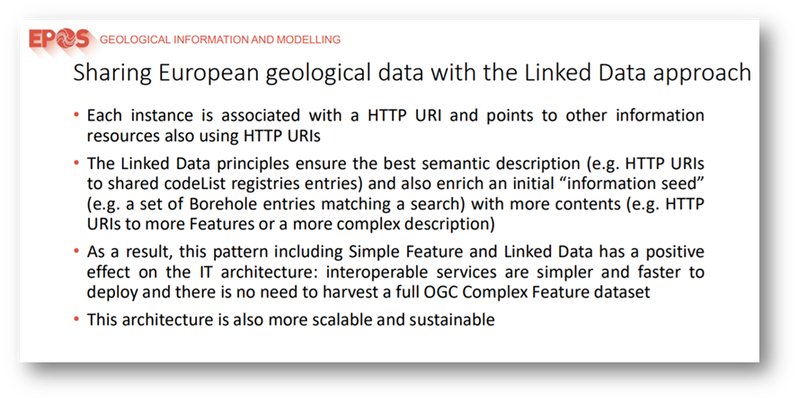
GO-DEPTH challenges
Challenge: use a simplified model but link to more detailed description
Solution: (still investigating feasibility) possible use of linked data in line with EPOS achievements
WORK IN PROGRESS

Slide 12

GO-DEPTH challenges
GO-DEPTH model as a National reference model
The developed model can represent a reference at a National level for the ongoing designing and implementation of the “Geological 3D subsurface models database” related to the National Geological Mapping Programme.
The model could be tested in EU initiatives (e.g. EPOS, Geological Mapping and Modeling Expert Group of EuroGeoSurveys) and furtherly implemented and extended.

Slide 13
THANK YOU

