Slide 1
GO-PEG
Schema creation and transformation processes
Tracing use case
"A step towards High Value Datasets"

Slide 2
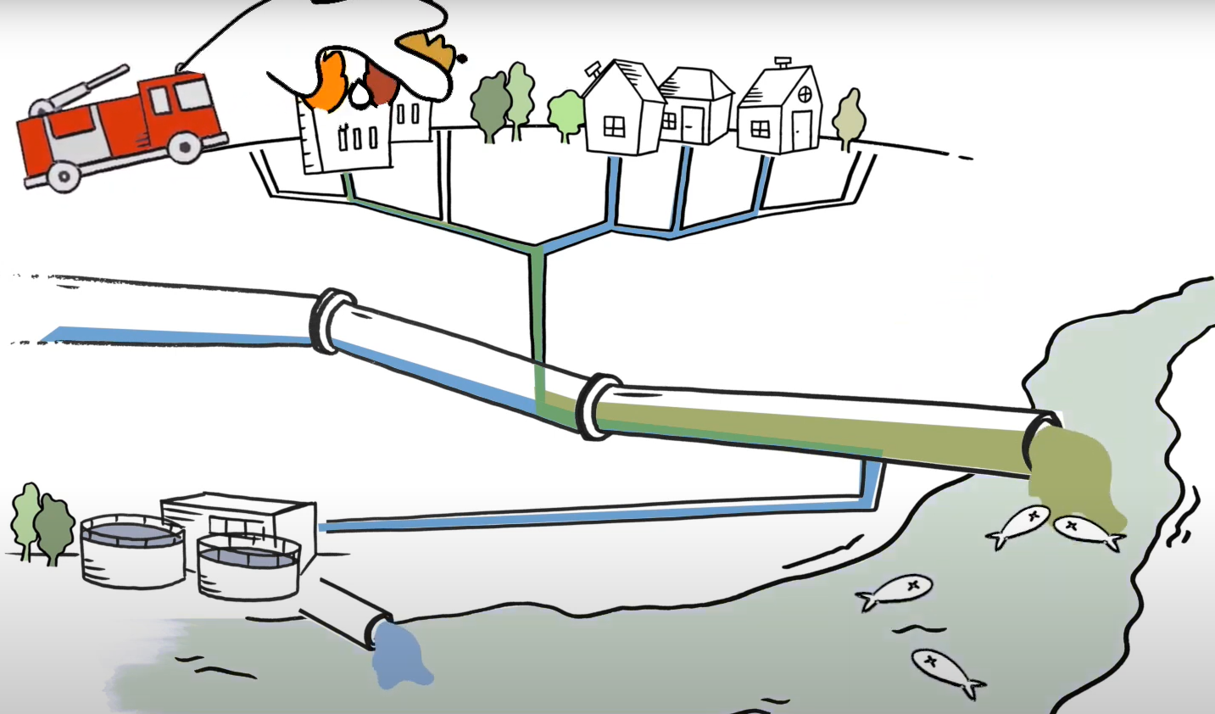
Tracing use case: overview
  Based on Wastewater Tracing application of the BE-GOOD project
  VMM
  GITHUB: Graph-Tracing-Engine

Slide 3
Tracing use case: overview
  Within GO-PEG
  Datasets ready for GTE
  Addition of pollution sources (upstream tracing) and additional affected entities
  Run as a service
  Integration of sensors(?)
  Quick reaction

Slide 4
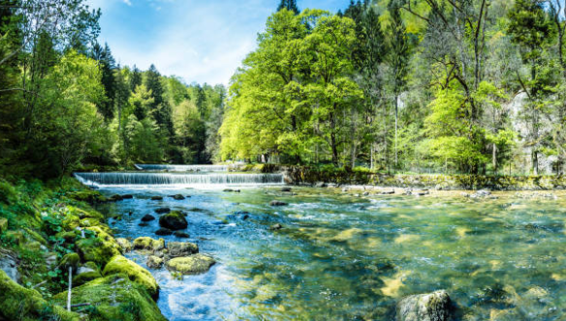
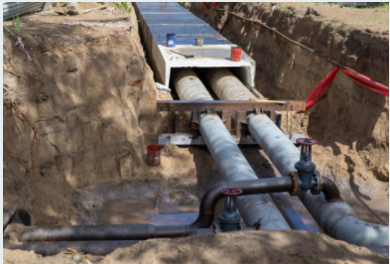
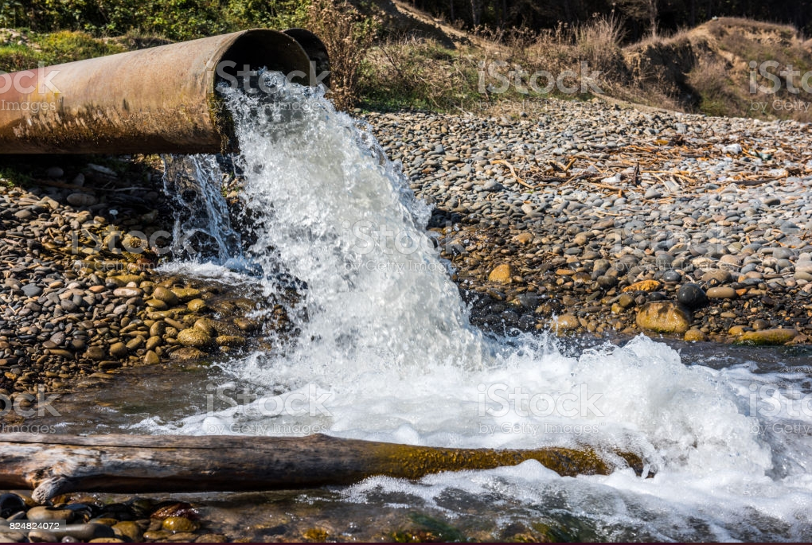
Tracing challenges
  Merge sewer and surface networks
  Implicit or explicit connections for the networks
  Connections between networks

Slide 5



Tracing challenges
  Connect external points or areas (sources/affected areas)
  Different levels of detail
  Optional: connection with sensors on the network

Slide 6



Tracing challenges
  Input data model
    Current tracing engine uses geotools
    Tracing should be able to run as a service
    Performance matters (in case of emergencies)
  Output model
    Clear communication
    Understood on mobile devices
    Non-geospatial info

Slide 7
Tracing challenges
  Transforming datasets with implicit connections > explicit
  Preserve/check previously created connections if data is updated
    Especially with manual corrections or external points
  Create flow directions from height if missing
  OGC – API Features

Slide 8
THANK YOU

