Slide 1
GO-PEG Workshop 3 – 29th June 2021
Schema creation and transformation processes
The INSPIRE Model-Driven Approach
http://inspire-extensions.wetransform.to/inspire-mda.html
Claudia Schulte, wetransform GmbH

Slide 2
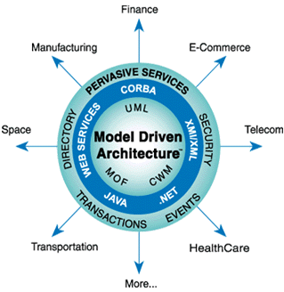
The INSPIRE Model-Driven Architecture Approach
General Intro or Reminder
INSPIRE goals are to foster or even force
  interoperability and
  availability of environmental geospatial data throughout Europe
  What means Interoperability ?
  system integration, systems being to easily exchange data as they are based upon or support a common conceptual model (standard)
  How to achieve interoperability ?
Apply Model-Driven Architecture Approach (MDA)
The fundamental idea: one platform independent model for
...common understanding, design, implementation, operation and maintenance and modification.
Image Source. https://modeling-languages.com/mda-abandoned-omg/

Slide 3
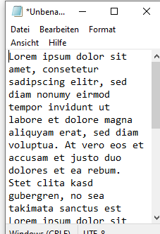
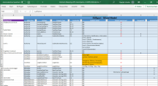
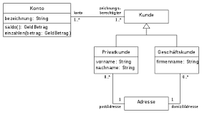
The GO-PEG approach is leaned on MDA:
UML
Processing stages
Stage 1
  From reality to conceptual schema
  → GO-PEG (semantic) schema harmonisation
Stage 2
  From conceptual schema to operational schema
  → GO-PEG (operational schema) creation
Stage 3
  Create data sets based on designed operational model
  → GO-PEG data transformation
Iterative during design and implementation phase
UML

Slide 4
The GO-PEG Approach
Stage 1: The conceptual phase
  Stage 1: From Reality to Conceptual Schema / Semantic Schema Harmonisation
  1) User-centered modelling
  Understand the needs of stakeholders and the reasons why the model should be developed
  → Use cases and use case scenarios allow us to structure these needs and the required information
  Identify user requirements
  Identify required information and based on this Spatial Object types
  Identify possible INSPIRE Themes and applicable feature types or other possible existing standards
  2) Design a conceptual model = platform independent model (PIM)
  Perform as-is analysis and gap analysis (Exist e.g. INSPIRE models that fulfil the requirements ?)
  Iterate over the conceptual model and feedback cycle between the contributers
  Test the model and consult stakeholders (Stage 2 and 3)
  Decide on a first release of the conceptual model, Document lessons learnt, open questions
  Outcome Conceptual Phase is a Platform Independent Model (PIM) e.g. designed in UML
Iterative during design and implementation phase

Slide 5
The GO-PEG Approach
Typical Challenges during conceptual phase
Agreement on exact meaning of Classes and Types
Defining association types between classes
Finding or defining suitable code lists or taxonomies
Handling and documentation of described mismatches, mapping decision
When is the semantic model „good enough“ to be released and proceed with the operational respectively logical model (Iterations!) ?

Slide 6
The GO-PEG Approach
Typical Mismatches in conceptual schema mapping
Conceptual Schema Mapping (CSM) is a complex task and it often involves inaccuracy as
  Schemas are defined for different purposes
  Schema mapping based on assumptions and known compromises is common
  mismatches are common
Typical mismatches (especially in the geospatial domain) based on:
  Formalized characteristics of the entities (differences on data types, value constraints, cardinality etc)
  Defined, agreed upon characteristics (differences not formalized but described in feature catalogue)
  Interpretated characteristics (differences assumed by modeler as model documentation is not existing)

Slide 7
The GO-PEG Approach
Stage 2: The operational phase
Stage 2: From conceptual schema to operational or logical Schema
  1) Decide on a data format / encoding for the operational schema
  Understand the needs of the system environment(s) and the requirements the model instances (data) shall fulfil
  Select due to requirements could be XML for system interchange, GeoPackage for desktop GIS, GeoJSON for transfer of a low amount of instances via web services
  This decision on the encoding highly influences usability, performance, storage space etc. of the physical model
  Step 2 Transfer the conceptual schema into the operational schema
  Could be done automatically or manually depending on tools availability, knowledge, accuracy of the design of the UML model of the conceptual schema etc.
  The classical process for INSPIRE schemas: annotations on UML → Automatic generation of XSDs
  → Outcome is a Platform Specific Model (PSM) e.g. designed in GeoJSON, XSD, JAVA etc
Iterative during design and implementation phase

Slide 8
The GO-PEG Approach
Typical questions/challenges during operational phase
Which encoding is fit-for-purpose ?
Is the selected encoding able to model the entities, relations etc. as defined in the conceptual schema ?
Are complex types allowed ?
Which schema language fits to the encoding ?
How complex is the modeling in the specific schema language ?
Will the performance of the resulting data sets be Ok ? Do I already know my data sizes?
Is my ETL Tool able to apply the chosen encoding ? What could be the alternative ?

Slide 9
The GO-PEG Approach
Stage 3: The mapping and transformation phase
Stage 3 Schema mapping and data transformation
  1) Collection of source datasets incl. quality assessment and fit-for-purpose analysis
  Collect data sets fit-for-purpose
  Analyse quality based on defined quality parameters (resolution/scale, actuality, documentation)
  2) setup mapping/alignment configuration towards the operational schema
  Apply ETL (Extract, Transform, Load) – Tools (e.g. FME, Hale Studio)
  E.g. mapping in hale»studio: Create detailed mapping configuration from source data to target data based on operational model (see next slide)
  3) Run your Mapping configuration
  4) Validate result against operational schema and data requirements
  → Outcome are datasets (instances) valid against the designed operational target schema
Iterative during design and implementation phase

Slide 10
The GO-PEG Approach
Stage 3: Typical challenges during alignment/mapping
Lack of source data documentation
Errors in source data resulting in validation errors during mapping
High scripting/programming effort in order to be able to do the mapping
ETL tool or general system limitations:
  Mapping limitations
  Complexity of the mapping and the handling of the ETL Tool
  File size limits
  Performance limits
  Data format limits

Slide 11
Resources
Objectc Management Group:
MDA – The Architecture of choice for a changing world. Online Article. URL: https://www.omg.org/mda/
Thorsten Reitz:
The INSPIRE Model-Driven Approach. Online Article. URL: http://inspire-extensions.wetransform.to/inspire-mda.html
Thorsten Reitz (2010):
A Mismatch Description Language for Conceptual Schema Mapping and Its Cartographic Representation. In: Fabrikant S.I., Reichenbacher T., van Kreveld M., Schlieder C. (eds) Geographic Information Science. GIScience 2010. Lecture Notes in Computer Science, vol 6292. Springer, Berlin, Heidelberg. https://doi.org/10.1007/978-3-642-15300-6_15

Slide 12
THANK YOU

